Slide 1


MULUNGUSHI UNIVERSITY
School of Engineering and Technology
Advanced Cybersecurity and Ethical Hacking
Unit 3: Reconnaissance and OSINT
ICS 441 • Lecture 2 Lecturer: Mr. M Bwalya
ICS 441 • Advanced Cybersecurity and Ethical Hacking • Unit 3: Reconnaissance and OSINT
1

Slide 2
Learning outcomes for Unit 3
By the end of this unit, students should be able to:
• Explain reconnaissance and OSINT in ethical hacking.
• Differentiate passive and active reconnaissance using safe examples.
• Identify authorised OSINT sources and the risks they reveal.
• Use reconnaissance findings to map attack surface and improve defence.
• Document findings using clear bullets, evidence and responsible language.
Reconnaissance is useful only when it is legal, scoped and defensive.
ICS 441 • Advanced Cybersecurity and Ethical Hacking • Unit 3: Reconnaissance and OSINT
2

Slide 3
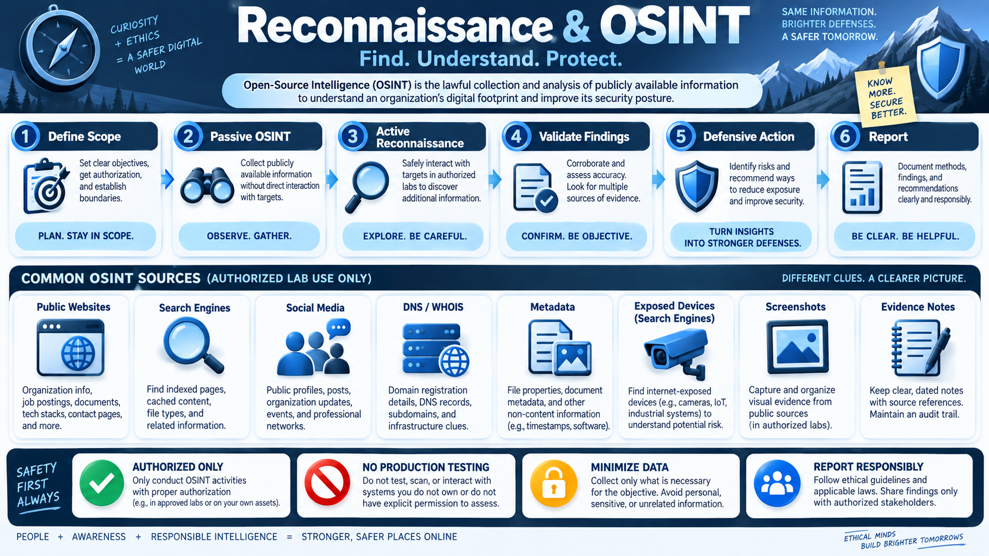
Big picture: Reconnaissance and OSINT
Generated teaching visual: OSINT should find, understand and protect — not harm.
ICS 441 • Advanced Cybersecurity and Ethical Hacking • Unit 3: Reconnaissance and OSINT
3

Slide 4
What is reconnaissance?
Clear definition
• Reconnaissance is the first stage of an ethical hacking or penetration test.
• It focuses on gathering information about a target before deeper testing.
• It helps testers understand assets, technologies, people, services and exposures.
• It must be performed only within authorised scope and approved rules of engagement.
• Good reconnaissance reduces guesswork and makes testing more focused.
First understand the target; then test safely.
ICS 441 • Advanced Cybersecurity and Ethical Hacking • Unit 3: Reconnaissance and OSINT
4

Slide 5
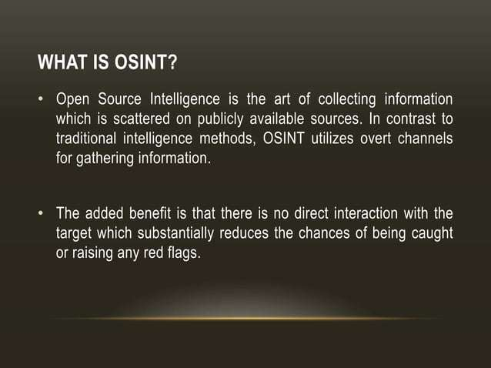
What is OSINT?
• Class discussion: what public information about an institution can attackers and defenders both see?
ICS 441 • Advanced Cybersecurity and Ethical Hacking • Unit 3: Reconnaissance and OSINT
5

Slide 6
Passive vs active reconnaissance
Area
Passive reconnaissance
Active reconnaissance
Teaching point
Interaction
No direct contact with target systems
Direct engagement with target systems
Passive is usually lower risk
Examples
Websites, search engines, job posts, social media
Ping, banner checks, approved scanning
Active actions require explicit authorization
Detection risk
Low visibility to the target
May appear in logs and alerts
Plan timing and rate limits
Use in labs
Public and safe learning tasks
Isolated lab or approved target only
Never test production without written consent
Main value
Build context and public footprint
Validate live services and exposures
Use both responsibly
Students must explain the legal boundary, not just define the terms.
ICS 441 • Advanced Cybersecurity and Ethical Hacking • Unit 3: Reconnaissance and OSINT
6

Slide 7
Passive reconnaissance
• No direct interaction with the target; it leaves no footprint on target systems.
• Sources include public websites, social media, job postings and search engines.
• Tools may include Google search operators, Shodan, public repositories and link analysis tools.
• Goal: identify infrastructure, technologies and possible exposures without alerting the target.
• Use only public data and document sources carefully.
Passive does not mean careless; privacy still matters.
ICS 441 • Advanced Cybersecurity and Ethical Hacking • Unit 3: Reconnaissance and OSINT
7

Slide 8
Active reconnaissance
• Active reconnaissance involves direct engagement with the target network or system.
• Examples include network discovery, banner grabbing and approved service checks.
• It has higher risk of detection because systems may log the activity.
• It must be approved in the ROE before it is attempted.
• Use rate limits, lab targets and monitoring to avoid disruption.
Active testing without approval is not ethical hacking.
ICS 441 • Advanced Cybersecurity and Ethical Hacking • Unit 3: Reconnaissance and OSINT
8

Slide 9
Why reconnaissance matters
For ethical hacking
For defence
• It is the foundation for later testing.
• It reveals technologies, entry points and exposed assets.
• It helps testers focus on high-value systems.
• It reduces blind scanning and wasted effort.
• It shows what attackers can learn before attacking.
• It helps security teams reduce public exposure.
• It supports early threat detection and monitoring.
• It strengthens incident response preparation.
ICS 441 • Advanced Cybersecurity and Ethical Hacking • Unit 3: Reconnaissance and OSINT
9

Slide 10
Reconnaissance, risk and compliance
Risk assessment value
Compliance and reporting value
• Exposed systems can be prioritised by likelihood and impact.
• Findings guide patching, hardening and access review.
• High-risk assets should be escalated early.
• The output becomes evidence for a risk register.
• Many security standards expect structured assessment evidence.
• A clear recon report shows due care and due diligence.
• Repeatable methods support auditability.
• Findings should be factual, dated and traceable.
ICS 441 • Advanced Cybersecurity and Ethical Hacking • Unit 3: Reconnaissance and OSINT
10

Slide 11
Reconnaissance workflow
A safe, repeatable learning process
1
2
3
4
5
6
Plan
Collect
Validate
Map
Prioritise
Report
Define scope and objectives.
Gather public information.
Confirm with multiple sources.
Group assets and exposures.
Link findings to risk.
Recommend defensive action.
Safety principle: collect only what is authorised, public, necessary and useful for defence.
ICS 441 • Advanced Cybersecurity and Ethical Hacking • Unit 3: Reconnaissance and OSINT
11

Slide 12
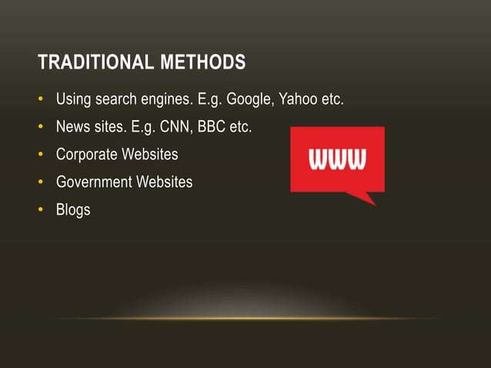
Traditional OSINT methods
• Ask students: Which of these sources would help map a university public footprint?
ICS 441 • Advanced Cybersecurity and Ethical Hacking • Unit 3: Reconnaissance and OSINT
12

Slide 13
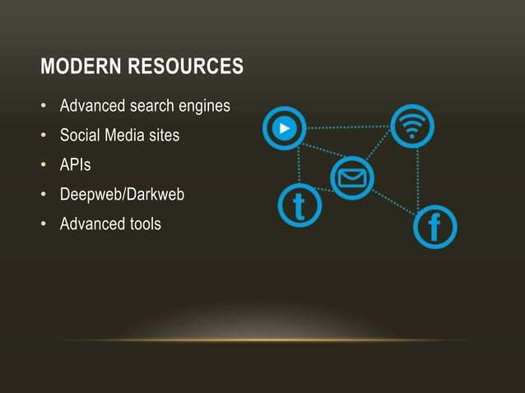
Modern OSINT resources
• Use only legal, public and approved sources; avoid restricted or unauthorised environments.
ICS 441 • Advanced Cybersecurity and Ethical Hacking • Unit 3: Reconnaissance and OSINT
13

Slide 14
Common OSINT source categories
Public web sources
People and organisation sources
Technical sources
• Institutional websites and subpages.
• News articles and public notices.
• Blogs, reports and public documents.
• Search engine cached pages.
• Social media posts and profiles.
• Staff directories and job adverts.
• Conference pages and project sites.
• Public professional profiles.
• DNS and WHOIS records.
• Certificate transparency records.
• Public repositories and leaks.
• Exposed service intelligence.
ICS 441 • Advanced Cybersecurity and Ethical Hacking • Unit 3: Reconnaissance and OSINT
14

Slide 15
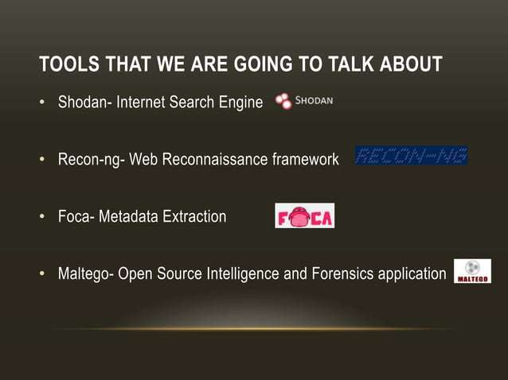
Tools introduced
ICS 441 • Advanced Cybersecurity and Ethical Hacking • Unit 3: Reconnaissance and OSINT
15

Slide 16
Shodan: internet-connected device intelligence
Notes under the subheading
• Shodan indexes information about devices exposed to the internet.
• It may show open ports, banners, service names and known vulnerabilities.
• Use it to understand exposure; do not interact with systems without permission.
• Filter results only for approved lab assets, owned systems or classroom-safe examples.
• Defensive value: find accidental exposure before attackers abuse it.
Shodan is a visibility tool; authorization still controls what you may test.
ICS 441 • Advanced Cybersecurity and Ethical Hacking • Unit 3: Reconnaissance and OSINT
16

Slide 17
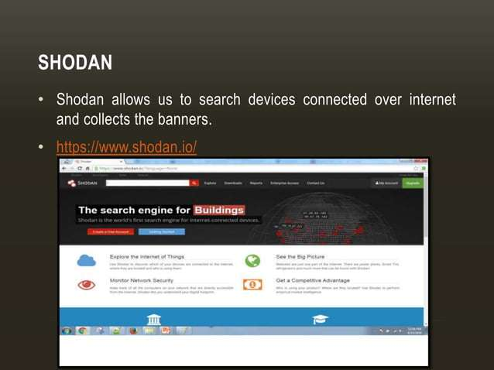
Shodan example visual
• Teaching prompt: what defensive questions should a security team ask after seeing exposed services?
ICS 441 • Advanced Cybersecurity and Ethical Hacking • Unit 3: Reconnaissance and OSINT
17

Slide 18
Recon-ng: modular reconnaissance framework
Notes under the subheading
• Recon-ng is a command-line, modular web reconnaissance framework.
• It automates information-gathering tasks such as DNS enumeration and contact discovery.
• It can integrate with APIs such as search engines or Shodan.
• It should be used only in lab or approved engagements.
• The professional skill is documenting method, source and defensive meaning.
Automation saves time, but it does not replace judgement.
ICS 441 • Advanced Cybersecurity and Ethical Hacking • Unit 3: Reconnaissance and OSINT
18

Slide 19
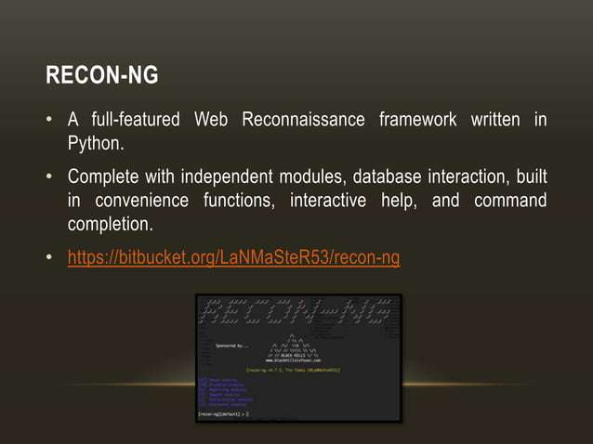
Recon-ng visual from attached notes
ICS 441 • Advanced Cybersecurity and Ethical Hacking • Unit 3: Reconnaissance and OSINT
19

Slide 20
FOCA and metadata extraction
Notes under the subheading
• FOCA focuses on metadata hidden in public documents.
• Metadata may reveal usernames, software versions, author names or network paths.
• Defenders should remove unnecessary metadata before publishing documents.
• Students should practise only on sample files provided for class.
• The ethical goal is to reduce accidental information leakage.
Metadata is “data about data” — and it can expose sensitive clues.
ICS 441 • Advanced Cybersecurity and Ethical Hacking • Unit 3: Reconnaissance and OSINT
20

Slide 21
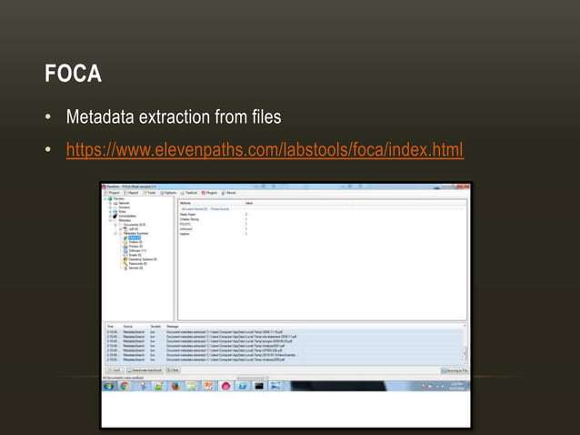
FOCA visual from attached notes
ICS 441 • Advanced Cybersecurity and Ethical Hacking • Unit 3: Reconnaissance and OSINT
21

Slide 22
Maltego: link analysis and investigation
Notes under the subheading
• Maltego maps relationships between people, domains, organisations and online identifiers.
• It presents information as a graph for easier investigation and analysis.
• It is useful for threat intelligence, fraud investigation and public-footprint review.
• Students should avoid collecting unnecessary personal information.
• Document sources and explain why each relationship matters.
Good analysts turn scattered clues into a clear map.
ICS 441 • Advanced Cybersecurity and Ethical Hacking • Unit 3: Reconnaissance and OSINT
22

Slide 23
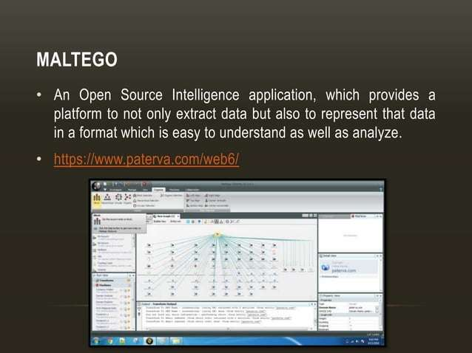
Maltego visual from attached notes
ICS 441 • Advanced Cybersecurity and Ethical Hacking • Unit 3: Reconnaissance and OSINT
23

Slide 24
Other useful OSINT tools
Have I Been Pwned
WHOIS lookup
• Checks whether an email or domain appears in known breaches.
• Useful for credential-exposure monitoring.
• Supports awareness and password-reset campaigns.
• Do not expose or shame affected users.
• Retrieves public domain registration information.
• Shows registrar, dates and name-server details.
• Helps map domain ownership and infrastructure history.
• Some details may be privacy-protected or outdated.
ICS 441 • Advanced Cybersecurity and Ethical Hacking • Unit 3: Reconnaissance and OSINT
24

Slide 25
Technology and reputation tools
BuiltWith
VirusTotal
• Detects website technology stacks such as CMS, frameworks and analytics tools.
• Helps identify outdated or risky public technologies.
• Useful for inventory and competitor awareness.
• Validate findings before reporting them.
• Checks file hashes, URLs and indicators against multiple engines.
• Useful for reputation and initial triage.
• Avoid uploading sensitive internal files without approval.
• Use hashes when possible to protect confidentiality.
ICS 441 • Advanced Cybersecurity and Ethical Hacking • Unit 3: Reconnaissance and OSINT
25

Slide 26
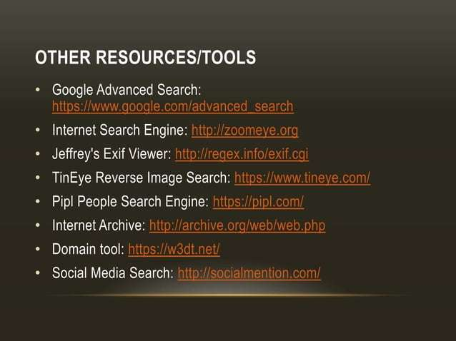
Additional OSINT resources
ICS 441 • Advanced Cybersecurity and Ethical Hacking • Unit 3: Reconnaissance and OSINT
26

Slide 27
DNS and WHOIS interrogation
• DNS records can reveal domains, subdomains, mail services and name servers.
• WHOIS may reveal domain registration and administrative information.
• Certificate records may reveal forgotten hostnames or test systems.
• Compare multiple sources before drawing conclusions.
• Report only what is relevant to the authorised security objective.
DNS often reveals how an organisation is structured online.
ICS 441 • Advanced Cybersecurity and Ethical Hacking • Unit 3: Reconnaissance and OSINT
27

Slide 28
Metadata and privacy concerns
• Metadata may include author names, edit history, software versions and timestamps.
• Published documents can unintentionally reveal internal systems or naming conventions.
• Images may contain location or device details when not cleaned properly.
• Security teams should use metadata review before publication.
• Students must practise data minimisation and avoid unnecessary personal data collection.
Do not collect more than you need to prove the risk.
ICS 441 • Advanced Cybersecurity and Ethical Hacking • Unit 3: Reconnaissance and OSINT
28

Slide 29
Building an attack-surface map
Assets
Entry points
Evidence
• Domains and subdomains.
• Web apps and APIs.
• Cloud services and storage.
• User endpoints and exposed portals.
• Login and password reset pages.
• File uploads and admin panels.
• Open services and public repositories.
• Third-party integrations.
• Source URL or screenshot.
• Date and time collected.
• Why it matters for risk.
• Recommended defensive action.
ICS 441 • Advanced Cybersecurity and Ethical Hacking • Unit 3: Reconnaissance and OSINT
29

Slide 30
Risk signals found during reconnaissance
• Exposed administration panels or login portals.
• Outdated technologies shown by banners or public pages.
• Public repositories containing secrets or configuration files.
• Leaked credentials or email patterns found in breach datasets.
• Documents containing metadata that reveals internal usernames or systems.
A recon finding becomes useful when it is linked to risk.
ICS 441 • Advanced Cybersecurity and Ethical Hacking • Unit 3: Reconnaissance and OSINT
30

Slide 31
How defenders reduce reconnaissance value
Reduce exposure
Strengthen identity
Monitor and respond
• Remove unnecessary public services.
• Clean metadata before publishing.
• Disable directory listing and verbose banners.
• Review public repositories.
• Enable MFA on exposed portals.
• Use least privilege and strong password policy.
• Monitor failed logins and unusual activity.
• Rotate exposed credentials immediately.
• Watch DNS, certificate and brand impersonation changes.
• Alert on scanning patterns.
• Maintain asset inventory.
• Track actions in the risk register.
ICS 441 • Advanced Cybersecurity and Ethical Hacking • Unit 3: Reconnaissance and OSINT
36

Slide 32
Knowledge check
Answer these questions in class
• What is the difference between reconnaissance and OSINT?
• Why is passive reconnaissance usually lower risk than active reconnaissance?
• Name three OSINT sources and explain what each can reveal.
• Why can metadata become a security or privacy concern?
• How can reconnaissance findings improve defensive security?
Use examples, not memorised definitions.
ICS 441 • Advanced Cybersecurity and Ethical Hacking • Unit 3: Reconnaissance and OSINT
39

Slide 33
Unit 3 summary
Key takeaways
• Reconnaissance is the first information-gathering stage of ethical hacking.
• OSINT uses publicly available information to understand the target footprint.
• Passive recon avoids direct target interaction; active recon requires stronger authorization.
• Tools such as Shodan, Recon-ng, FOCA and Maltego help organise public intelligence.
• The professional outcome is better defence: reduced exposure, stronger monitoring and clear reporting.
Find. Understand. Protect.
ICS 441 • Advanced Cybersecurity and Ethical Hacking • Unit 3: Reconnaissance and OSINT
40

